Slide 1

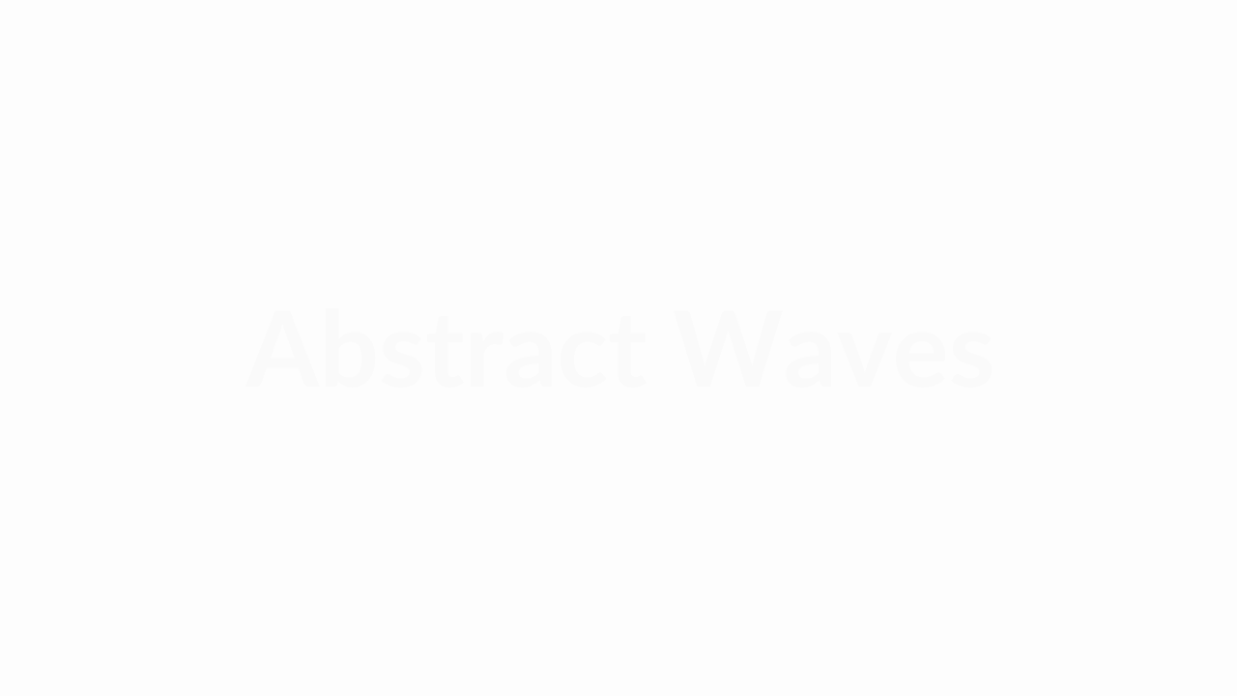
FINAL PROJECT PRESENTATION
2D Fourier Transform Implementation & Image Denoising
Engineering Mathematics • Fall 2025
Team Members: [Member A], [Member B], [Member C]

Slide 2
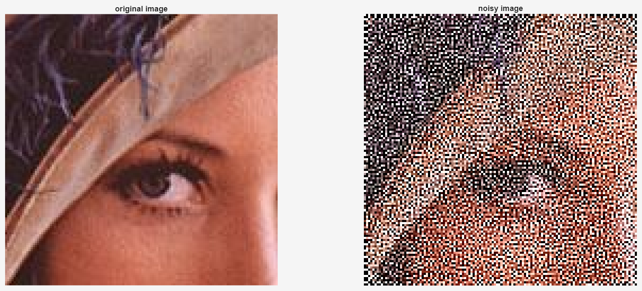
Program execution result
03

Slide 3
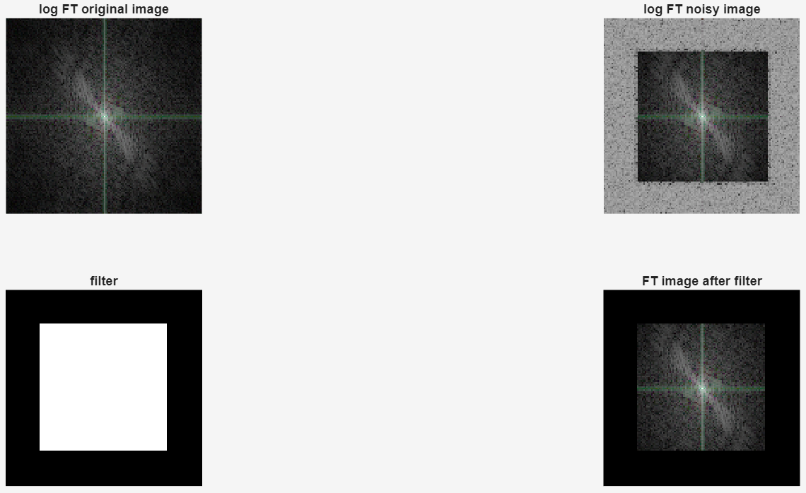
Program execution result
03

Slide 4
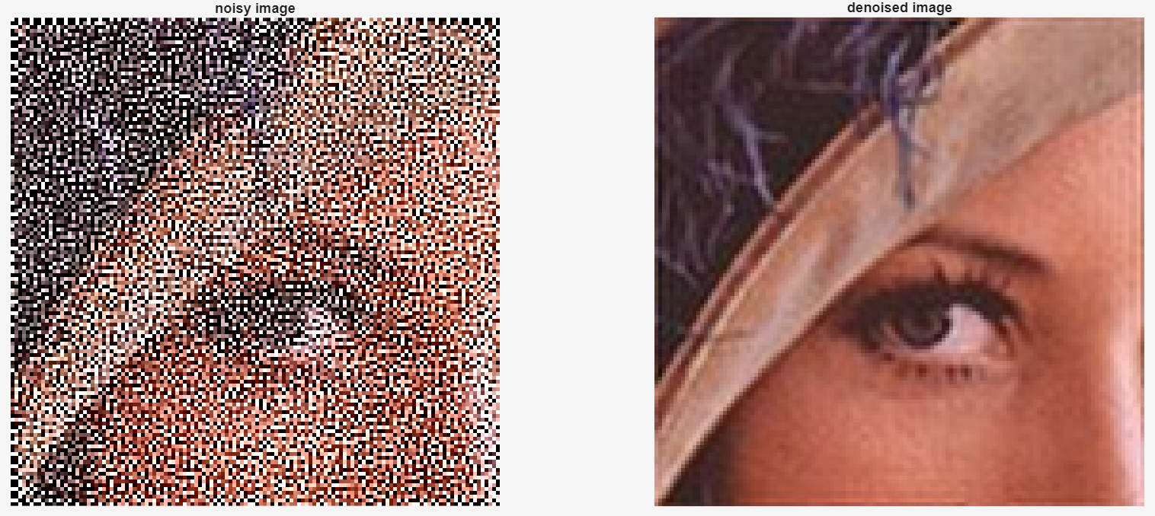
Program execution result
03

Slide 5

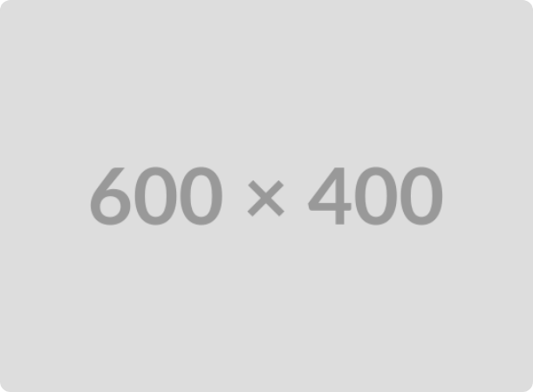
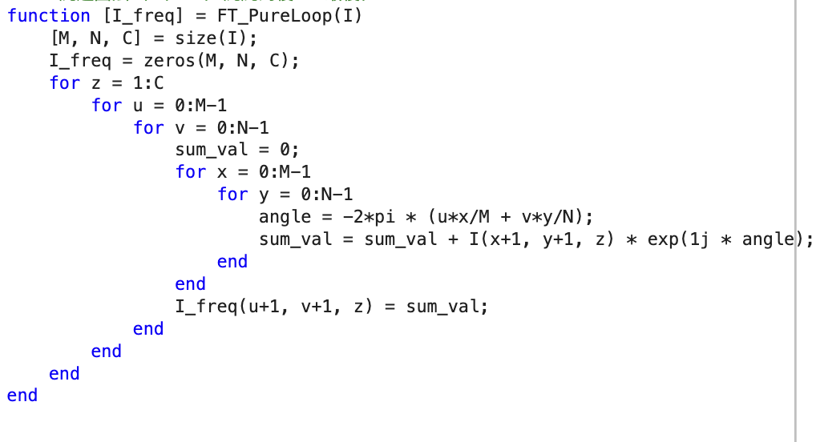
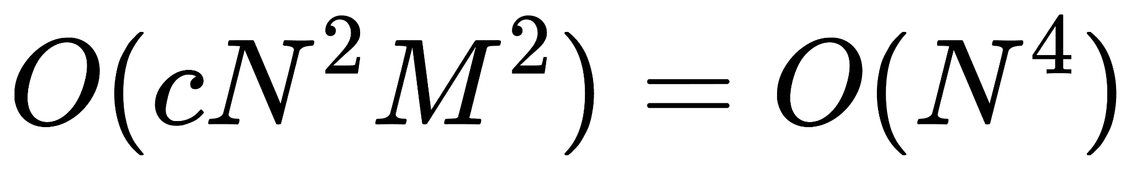
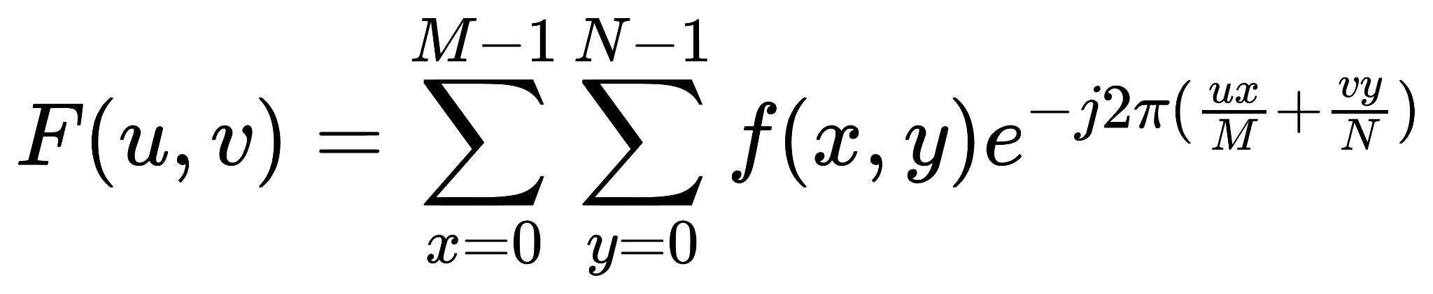
Methodology: Brute-force 5 times for-loop
Time complexity?
Easy to understand, but…
Execution time:56s (N=128)
03

Slide 6
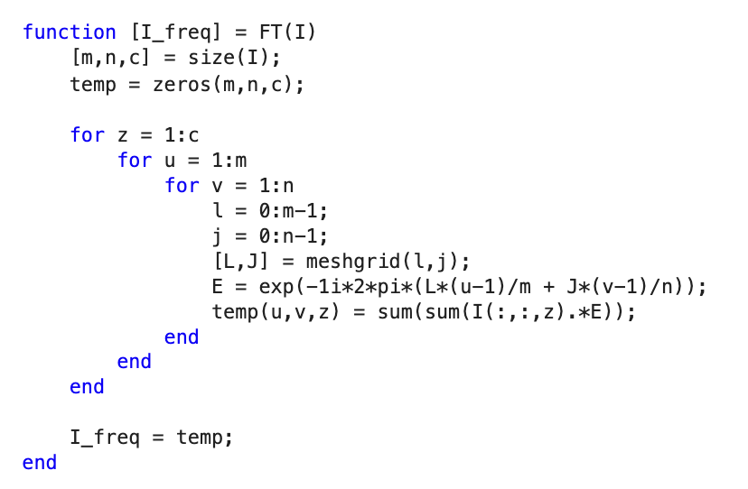
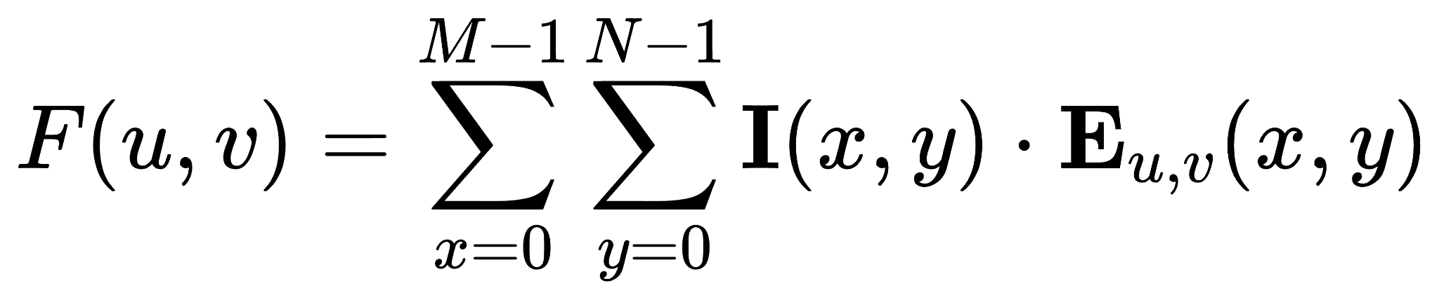
Methodology: semi-vectorized
Time complexity?
A bit faster, but still…
Memory: Do you want to kill me?
Execution time:13.6394s (N=128)
03

Slide 7
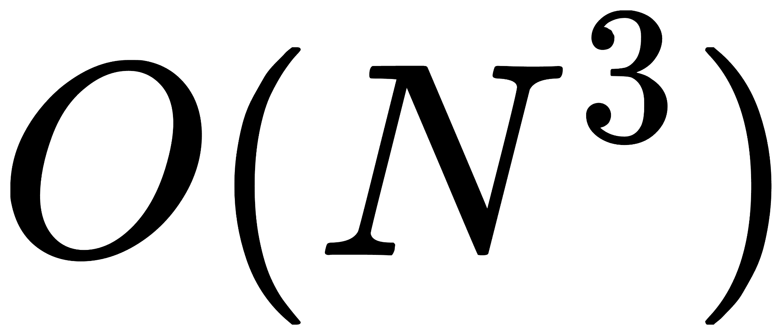
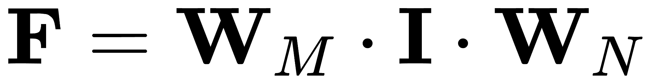
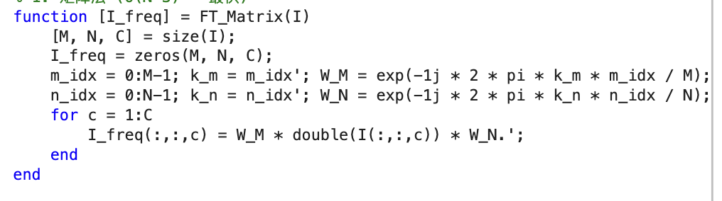
Methodology: fully vectoried
Time complexity?
SUPER fast, but abstract
Execution time:0.0098s (N=128)
03

Slide 8
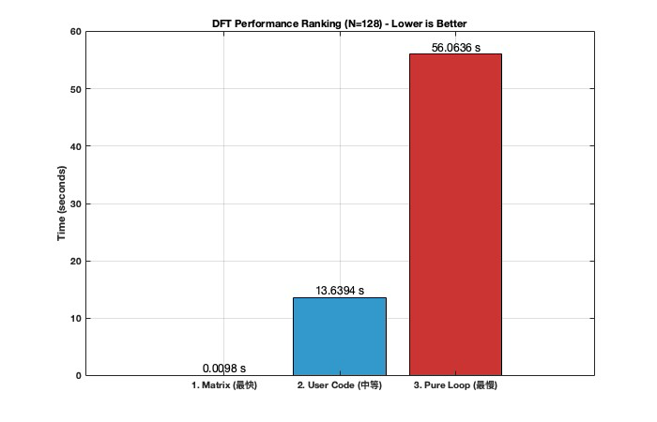
Comparison
Time complexity matter
matrix operation is highly efficient in Matlab
Saving Matrix cost a lot memory
03

Slide 9
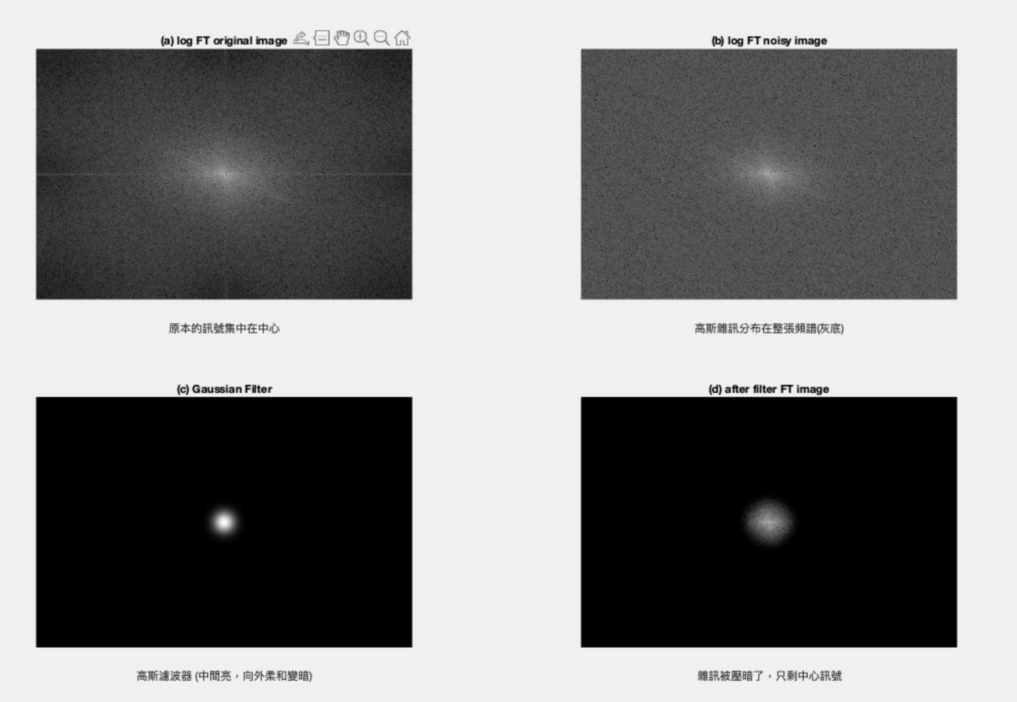
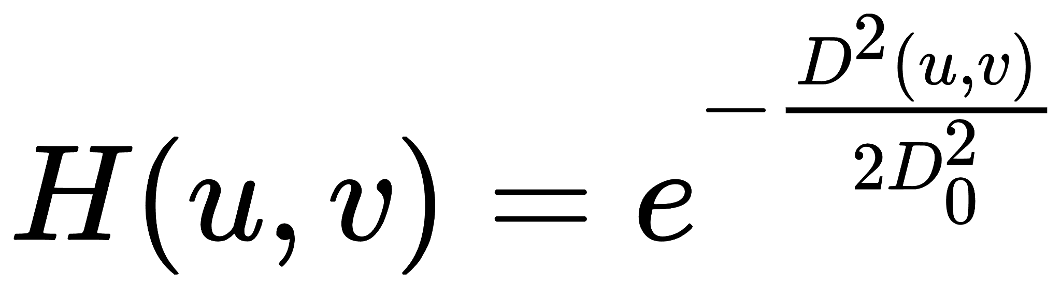
Gaussian filter
03

Slide 10
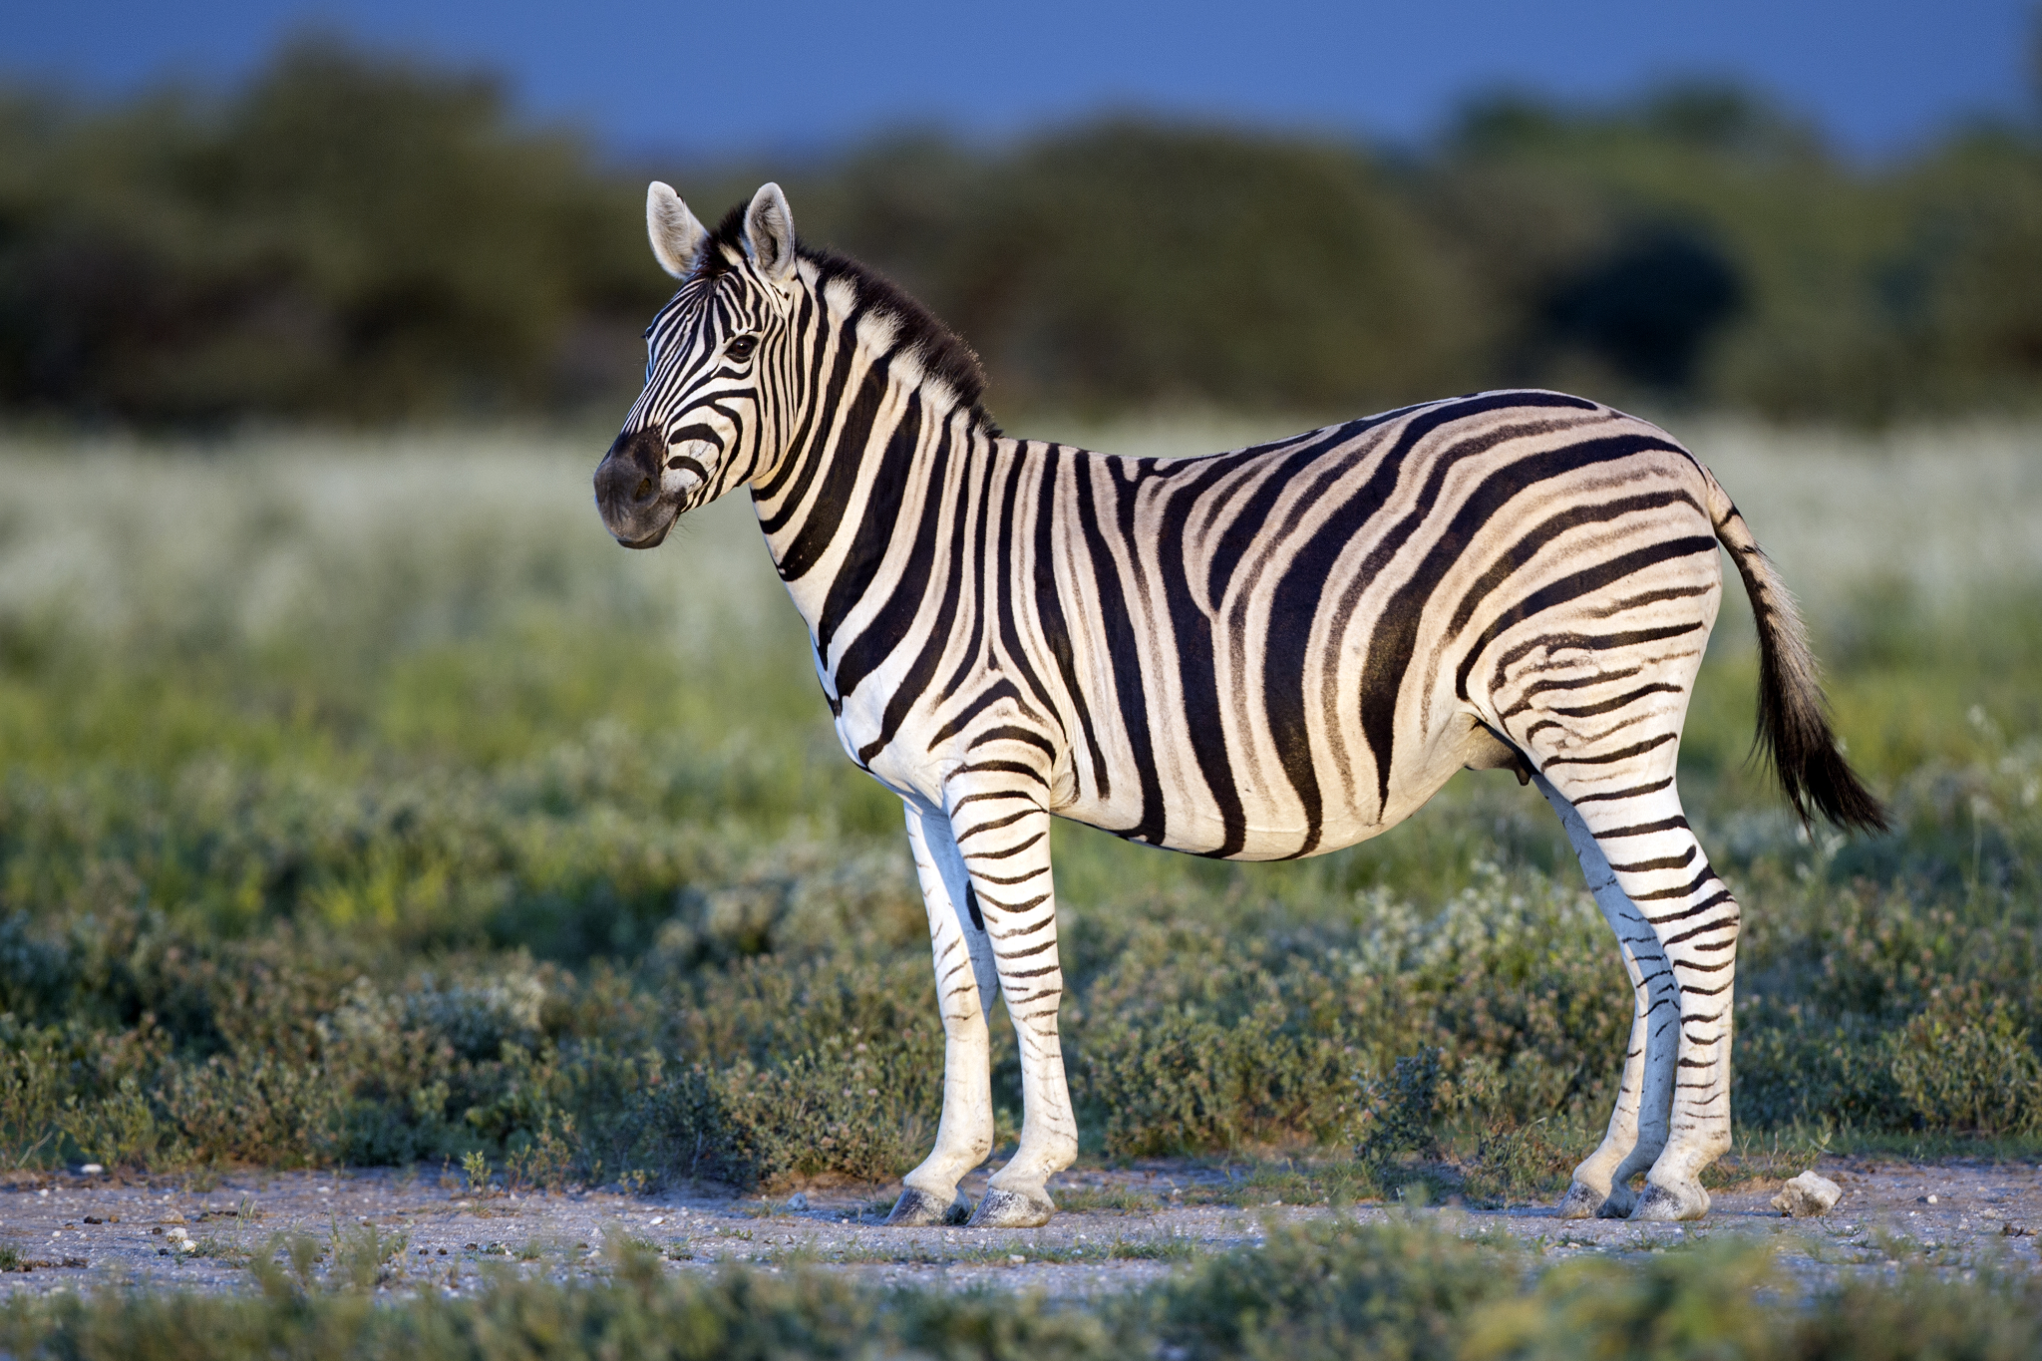

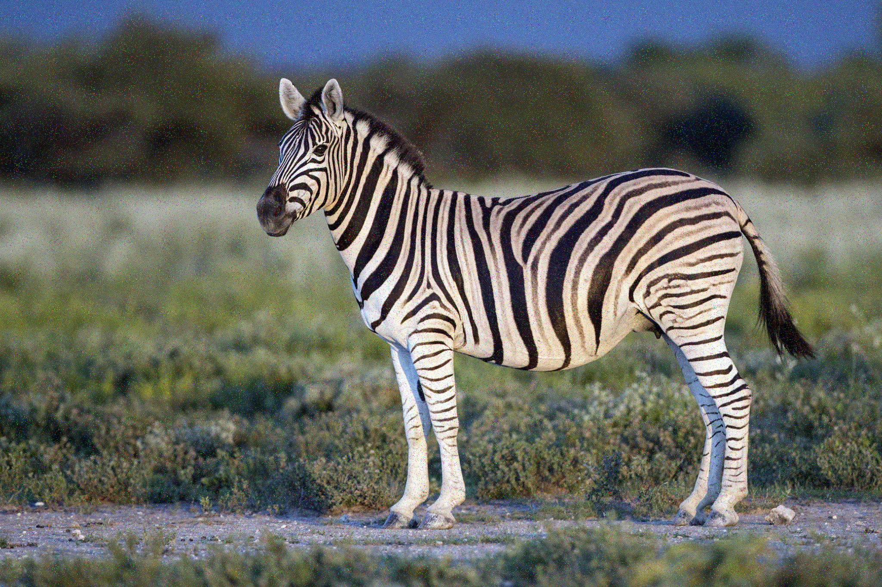

Experiment: Filter Comparison
Comparing the visual artifacts produced by different frequency domain filters on Gauss noise.
Original picture
Noisy Input
Zebra image
Zebra image + Gauss Noise
04

Slide 11
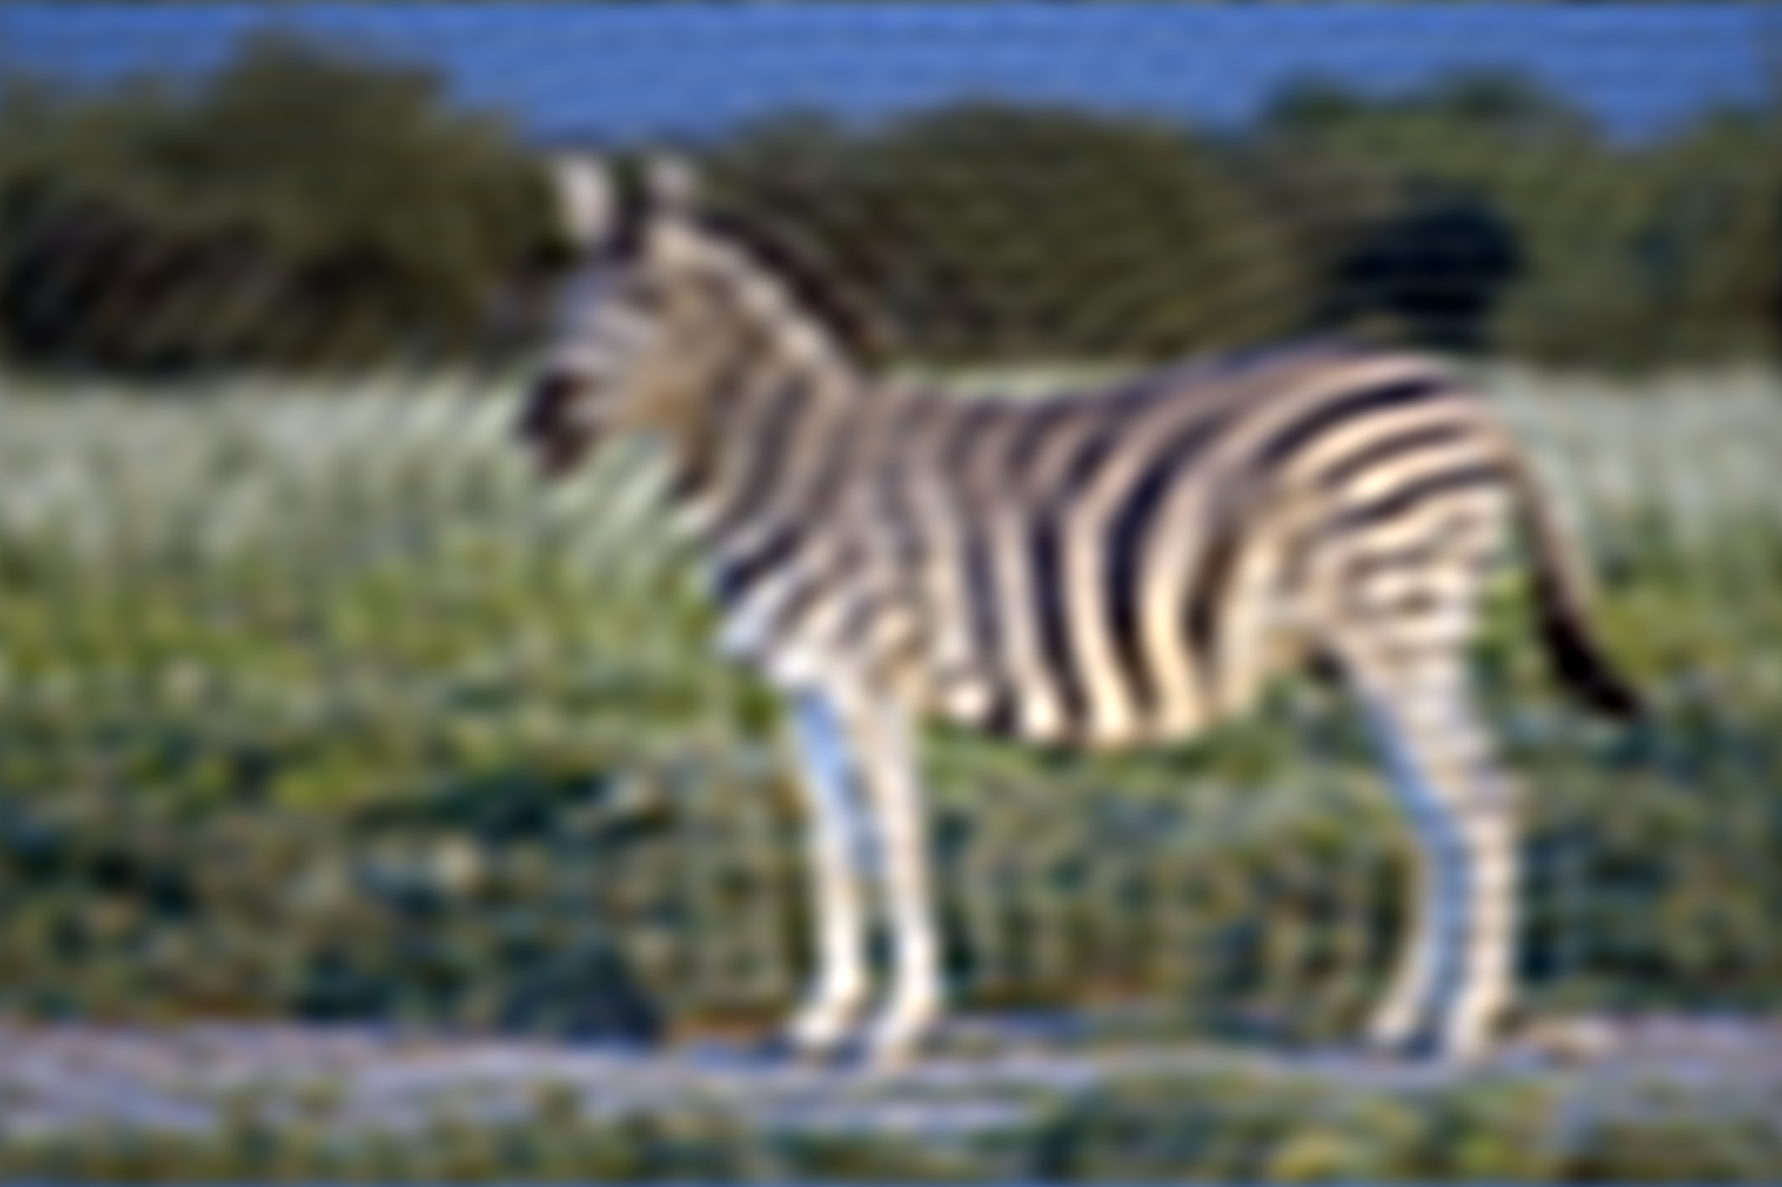

Experiment: Filter Comparison
Comparing the visual artifacts produced by different frequency domain filters on Gauss noise.
Ideal Filter
Gaussian Filter
visible "Ringing" artifacts
Smoother transitions, natural look
04

Slide 12
Experiment: Filter Comparison
Comparing the visual artifacts produced by different frequency domain filters on Salt Pepper noise.
Original picture
Noisy Input
Zebra image
Zebra image + Salt Pepper Noise
04

Slide 13


Experiment: Filter Comparison
Comparing the visual artifacts produced by different frequency domain filters on Salt Pepper noise.
Ideal Filter
Gaussian Filter
Sharp edges but visible "Ringing" artifacts
Smoother transitions, natural look
04

Slide 14
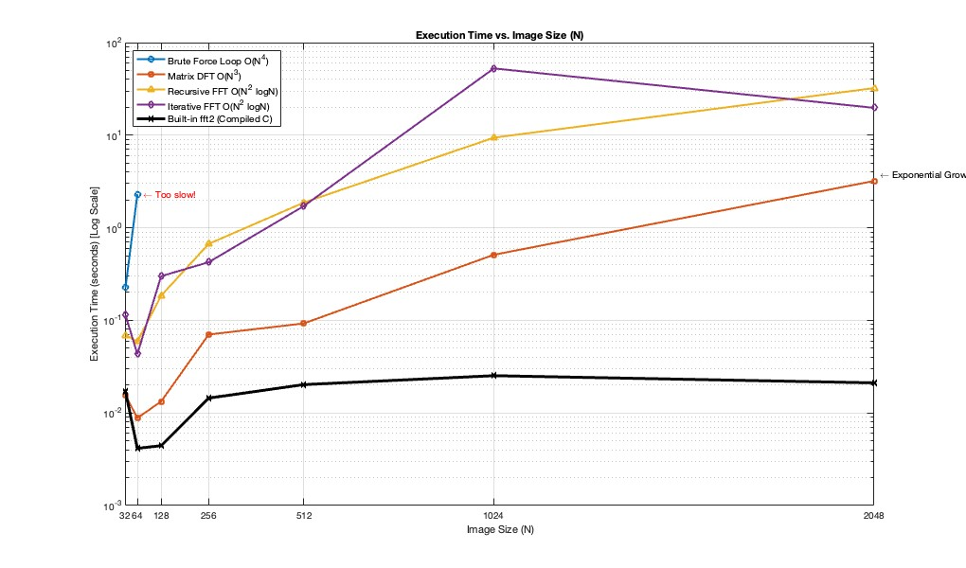
Comparison of different algorithm
04

Slide 15






Conclusion
Efficiency
Visual Quality
Application
Matrix optimization is essential for MATLAB. beats , but FFT is the ultimate solution for large N.
Gaussian Filters are superior for general photography as they avoid the artificial ringing artifacts of Ideal Filters.
Frequency domain filtering is uniquely powerful for removing Periodic Noise patterns.
06

Slide 16
Division of labor
賴致全 | 夏詡程 | 曾健庭
延伸不同noise, filter 複雜度討論、比較 簡報 | 簡報 | main程式撰寫
04

